Slide 1

What is The MLC?
Notes:
This presentation will give you an overview of the Mechanical Licensing Collective – otherwise known as The MLC
[Do not read this note aloud]
The copyright in this presentation is owned by The MLC and is made available to educators who have specifically requested access to The MLC’s Educator Toolkit, to use in their classes and for presentations about The MLC made to their campus community. This PowerPoint file may NOT be shared with students or posted on a Learning Management System.

Slide 2
Presentation Overview
The MLC’s Purpose
Copyright Basics
Mechanical Licenses and How to Get One
How the MMA Changed Mechanical Licensing
Mechanical Licensing Terminology and Responsibilities
The Digital Royalties Landscape and The MLC
Membership in The MLC
Mechanical Royalties
Historical Unmatched Royalties
Notes:
[Read the slide]

Slide 3


The MLC’s Purpose
DSPs in U.S.
Sound Recordings Only Interactive Streams
Limited Downloads
Permanent Downloads
Musical Works Rightsholders
Music Publishers
Publishing Administrators
Self-administered writers
Ex-U.S. CMOs
CERTAIN TYPES OF DIGITAL SERVICE PROVIDERS
RIGHTSHOLDERS
The MLC is the EXCLUSIVE administrator of the new blanket digital mechanical license
Notes:
The MLC plays a key role in an important type of revenue in the music industry.
A type of royalties called digital mechanical royalties flow into and out of the MLC
They flow from certain types of digital service providers and flow to certain types of rightsholders
Let’s dig a bit deeper [trigger more animation]
The MLC collects mechanical royalties from digital service providers, operating in the U.S., that make Sound Recordings of musical works available via interactive streaming, limited downloads and permanent downloads.
The MLC then pays the parties who are entitled to receive the royalties, including music publishers, publishing administrators, self-administered writers, and mechanical rights organizations based outside of the U.S. (referred to as CMOs)
The MLC is the only organization authorized to collect and distribute the royalties paid pursuant to the new blanket mechanical license created by the Music Modernization Act

Slide 4


Copyright Basics: Musical Works and Sound Recordings
Songs or Compositions
Recordings
(Copyright law calls these MUSICAL WORKS )
Created by:
Songwriters or Composers and Lyricists
Often administered by:
Music Publishers
The music (a melody, rhythm, and/or harmony that could be expressed in a system of musical notation) and the words (lyrics) if any
(Copyright law calls these SOUND RECORDINGS)
Created by:
Recording Artists and Producers
Often distributed by:
Record Companies
The recording of sounds.
A Sound Recording is not the same as an Audiovisual Work (video)
Example: The song “Yesterday” was co-written by John Lennon and Paul McCartney
Example: The song “Yesterday” was first performed and recorded by The Beatles, but numerous other artists subsequently performed and recorded (or “covered”) this song, including Elvis Presley, Aretha Franklin, and Frank Sinatra
Notes:
Before you can understand what mechanical licensing is, you need to understand a bit about the copyright law
There are two types of works that copyright law protects which are involved in mechanical licensing
The first is the song (sometimes called a composition). The U.S. copyright law calls these musical works
These are created by songwriters or composers and lyricists, and often administered by music publishers
A Musical Work is the music (the melody, rhythm, and/or harmony that could be expressed in a system of musical notation, and the words (lyrics) if any
For Example: The song “Yesterday” was co-written by John Lennon and Paul McCartney
The other type of work is a Recording. The copyright law calls these sound recordings
These are created by Recording Artists and Producers, and typically distributed by Record Companies
These are essentially the recording of sounds.
Note that a Sound Recording is not the same as an Audiovisual Work (video)
For Example: The song “Yesterday” was first performed and recorded by The Beatles, but numerous other artists subsequently performed and recorded (or “covered”) this song, including Elvis Presley, Aretha Franklin, and Frank Sinatra. This is one of the most covered songs of all time.

Slide 5








Copyright Basics: Rights and Revenue
©
MUSICAL WORK EXCLUSIVE RIGHTS
REPRODUCE
DISTRIBUTE
PUBLICLY
PERFORM
PUBLICLY
DISPLAY
PREPARE DERIVATIVES
Sheet Music
CDs and Vinyl Records
Interactive Streams
Downloads
Live Performances
Terrestrial Radio (FM)
Interactive Streams
Non-interactive Streams
Lyrics on Karaoke screen
Synchronization
Sample (Interpolation)
Remix
MECHANICALS
Notes:
The U.S. copyright law gives owners of musical works five exclusive rights.
The right to reproduce the work, distribute the work, publicly perform the work, publicly display the work, and prepare derivatives of the work
Different uses of music involve one or more rights under the copyright law
[Show just the 4 under the first two rights] These examples here all involve the reproduction and distribution of a musical work.
[Show the dotted outline of the three examples under the first two rights and the yellow arrow] In the U.S., when we refer to a mechanical license, we are talking about permission to reproduce and distribute musical works in sound recordings which are then included in physical products such as CDs and vinyl records, interactive streams and downloads
[Show the yellow box around the two examples under the first two rights and The MLC logo] The MLC is only involved in digital mechanical licensing and royalties.
We will explain the difference between an interactive stream and a non-interactive stream on the next slide.
Note how this type of use is different from publicly performing [show examples] or displaying [show example],or preparing a derivative [show examples] of the work.

Slide 6









Mechanical Licenses
Examples of uses of musical works that require a mechanical license
Phonorecords and digital phonorecord deliveries
DIGITAL RECORDS:
INTERACTIVE STREAMING
& LIMITED DOWNLOADS
PHYSICAL RECORDS:
VINYL AND CD
DIGITAL RECORDS:
PERMANENT DOWNLOADS
Notes:
A mechanical license is needed in order to reproduce and distribute a musical work as a sound recording in audio-only physical and digital records, what the copyright law calls phonorecords and digital phonorecords
The first example of a phonorecord is physical records such as a vinyl record or CD.
The second example is a permanent download. These involve the consumer buying a file, downloading it and keeping it permanently.
The third example are interactive streaming and limited downloads. An interactive stream is one where the consumer has control over which recording to stream on a digital services. It is sometimes called on-demand streaming. A limited download is where a download to a device happens but it is only accessibly in a limited way, such as for a limited number of plays or a limited time. One example of this is when a consumer picks a setting in their favorite streaming app to have their playlist available for offline listening, which is what happens when the device is not connected to the internet but you can still here the music. For licensing purposes, limited downloads are categorized together with interactive streaming. Some examples are services like Spotify, Apple Music, and Amazon Music
Non-interactive streaming services, which are essentially digital radio, where the consumer can pick the station or playlist, but not the specific recording to listen to, do not require mechanical licenses, but do require other types of licenses.

Slide 7
Mechanical Licenses
HOW DO YOU GET A MECHANICAL LICENSE?
VOLUNTARY
LICENSE
COMPULSORY LICENSE
Obtained from the
Copyright Owner or Administrator
of the work
Copyright Owner or Administrator
can decide
whether or not to grant a license
If it is available, obtained by adhering
to the procedures set out in the
U.S. Copyright Law §115
Copyright Owner or Administrator
cannot prevent
the granting of a license
License terms including royalty rates are negotiated
License terms are set by statute or federal regulation
Royalty rates are set by the Copyright Royalty Board
There are several different compulsory licenses that exist in the U.S. Copyright Law in addition to this one
Notes:
So how does someone get a mechanical license? There are two ways.
One way is to obtain a voluntary license.
To do this, the party needing the license would contact the copyright owner or administrator of the work. And they can decide whether or not to grant a license
The parties would negotiate the terms of the license including the royalty rate and how often royalties are paid
The other way is to obtain a compulsory mechanical license if one is available.
To do this, the party seeking a license has to review the criteria established in the law to see if the musical work and intended use is eligible, and if it is, they have to adhere to the procedures set out in the copyright law, in section 115, and federal regulations. In this case, the copyright owner or administrator cannot prevent the granting of the license – the law grants the license
The license terms are set by statute or federal regulation. The royalty rates are set by the Copyright Royalty Board, a three-judge panel established to do exactly this sort of thing. There are several different compulsory licenses that exist in the U.S. copyright law.

Slide 8
Before the Music Modernization Act
Who
Record Companies (CD and Vinyl Records, and Permanent Downloads)
Digital Service Providers (Interactive Streams and Limited Downloads)
What
Work-by-work mechanical license
  In practice, more like share-by-share basis
How
Try to secure a voluntary mechanical license, or
Secure a compulsory license if the musical work is eligible
  §115: Eligible after the musical work has been distributed in phonorecords (physical or digital), in the U.S., to the public for their private use, with permission from the musical work copyright owner
Issues
No public authoritative database of musical works ownership information
Work-by-work licensing is not scalable – requires licensor to conduct extensive research for each work
Not all Musical Works rightsholders were receiving
their mechanical royalties from the digital service providers
Notes:
The Music Modernization Act of 2018 (or MMA for short) was a very important change to the U.S. copyright law.
One of the key things that it changed was how mechanical licensing for digital uses of music works is done.
To understand what it changed and why we needed the change, you need to first understand how things worked before the MMA
Before the MMA, record companies and digital service providers sought mechanical licenses for uses of musical works on physical products and permanent downloads, and for interactive streams and limited downloads.
They sought a mechanical license on a work-by-work basis. They had to secure a separate license for each musical work they intended to use, and in practicality, they sought mechanical licenses from each co-owner of a share of each musical work.
The way they did this was to try to secure a voluntary license, or look to see if the work was eligible for a compulsory license
In both cases, they had to research who owned or administered the copyright and request a license or serve notice that they were relying on the compulsory license
This research could be difficult because there was no public authoritative database of musical works ownership information. And with tens of thousands of tracks uploaded to services every day, this solution was not scalable.
This was not working well. Not all musical works rightsholders were getting paid their digital mechanical royalties and services were getting sued. Nobody was happy.

Slide 9
Music Modernization Act of 2018
Title I: Musical Works Modernization Act
Changes to §115
Blanket License |  | Eligibility |  |  |  | Public Database
Created a Blanket Compulsory Mechanical License for Interactive Streaming Limited Downloads Permanent Downloads |  | Expanded the compulsory license eligibility criteria for Digital Service Providers |  | Mandated the creation of a mechanical licensing collective to administer the new Blanket license |  | Mandated that The MLC establish and maintain a publicly available musical works ownership database
Notes:
The Music Modernization Act of 2018 changed things
The Act was made of up three titles, the first of which deals with mechanical licensing and is called the Musical Works Modernization Act
It created a Blanket Compulsory Mechanical License for interactive streaming, limited downloads, and permanent downloads
It expanded the compulsory license eligibility criteria
It mandated the creation of a mechanical licensing collective to administer the new blanket license
And it mandated The MLC establish and maintain a publicly available musical works ownership database

Slide 10
Changed by the Music Modernization Act
Who
Digital Service Providers (U.S. DSPs operating Interactive Streaming and Download services)
What
Blanket mechanical license
  Only need to obtain one blanket license for all eligible musical works
  Work-by-work voluntary licenses remain an option
How
Secure a compulsory license if the musical work is eligible
  §115: Does not have to previously been reproduced and distributed to the public – if the record company obtains a first use mechanical license from the copyright owner(s) and allows DSP to distribute their recording, that is enough
Notes:
After the MMA, the mechanical licensing activities of digital services providers changed.
Now those providers only need to obtain one license, the blanket license, and not a license for each individual work, although the voluntary license is still an option.
The eligibility was also expanded so that the compulsory license is available even if the work has never been reproduced and distributed before. The record company continues to have a responsibility to secure a voluntary mechanical license granting it permission for the first use of a musical work in a sound recording in phonorecords, (that has not changed), but once that happens and the record company gives the DSP permission to reproduce and distribute its sound recording, then the work is eligible for the DSP to distribute pursuant to the blanket compulsory license even if the work had never been distributed previously.

Slide 11
Mechanical Licensing - Terminology
First Mechanical Use
Compulsory License
First time a musical work will be:
incorporated into a sound recording
the sound recording will be distributed to the public for their private use
as an audio-only phonorecord (vinyl, CD, etc.), or digital phonorecord delivery (DPD) (interactive stream, permanent or limited download)
License is created by the law (§115), not negotiated between the parties
Law and related regulations set the eligibility requirements and rules that must be followed (first use or second + comes into play)
Rules are different for record labels and digital services (DSPs)
“Statutory” Royalty Rates are set by the Copyright Royalty Board and published in the Code of Federal Regulations
Second + Mechanical Use
Second time or later time this happens
“Cover” sound recordings
Change in format/configuration that comes after the first phonorecord or DPD is released
Notes:
So let’s do a recap on some mechanical licensing terminology that we have introduced
The first is the First Mechanical Use, or First use for short
This is the first time a musical work is incorporated into a sound recording.
and the sound recording is distributed to the public, for their private use
as an audio-only phonorecord (such as a vinyl record or CD), or digital phonorecord delivery such as an interactive stream, permanent or limited download.
A Second or later Mechanical Use is the second time or later this happens. This can happen in two ways.
One way is with a cover sound recording. For example, The Beatles recording of Yesterday by John Lennon and Paul McCartney was a first use. The recordings of Yesterday by Aretha Franklin, Elvis Presley, Frank Sinatra and many others are cover recordings.
The other way is when a different format or product configuration is released after the first use. For example, if the first use of Yesterday by the Beatles was released on vinyl, and then later released on tape, CD, permanent download and as an interactive stream, those later uses are also considered second or later mechanical uses because they came later in time in a different format.
The Compulsory Mechanical License is created by section 115 of the U.S. Copyright law.
It is granted by the law instead of negotiated between the parties.
The law and related regulations set the eligibility requirements and rules that must be followed. Whether a use is a first use or a second or later use is a factor to consider.
The rules are different for record labels and digital services
The statutory royalty rates are set by the Copyright Royalty Board and published in the code of federal regulations.
For a compulsory license, the statutory royalty rates must be used.

Slide 12

The New Blanket License
Applies to:
Audio only
Digital Mechanical Uses of Musical Works
  Interactive Streams
  Limited Downloads
  Permanent Downloads
DSPs operating in the U.S.
Does NOT Include:
Physical Mechanical Uses (e.g., CDs, Vinyl)
Video Streams or Video Downloads
Public Performance
Use of Lyrics
Non-Interactive Streams
(e.g., Satellite, Internet Radio)
Uses outside of the U.S.
Notes:
Let’s talk about the new blanket license.
The new license only grants permission for audio-only digital mechanical uses of musical works in the United States
That includes interactive streams, limited downloads, and permanent downloads
And only applies to DSPs operating in the U.S.
The license does not apply to mechanicals for physical products such as CDs and vinyl, video streams or downloads, public performance of musical works, the use of lyrics, or non-interactive streams. It also does not apply to uses outside of the U.S.

Slide 13



Mechanical Licenses – Who Does What
Product / Configuration
First Mechanical Use
Second + Mechanical Use
Royalty Flow
Interactive Stream / Limited download
Record Label: obtains voluntary first use mechanical license then DSP: (a) relies on the blanket compulsory license, or (b) obtains a voluntary license
Record Label: does not need to obtain a mechanical license DSP: (a) relies on the blanket compulsory license or (b) obtains a voluntary license
Either (a) DSP → The MLC → Publisher → Songwriter, or (b) DSP → Publisher → Songwriter
Permanent Download where DSP will secure license
Record Label: obtains voluntary first use mechanical license then DSP: (a) relies on the blanket compulsory license, or (b) obtains a voluntary license
Record Label: does not need to obtain a mechanical license DSP: (a) relies on the blanket compulsory license or (b) obtains a voluntary license
Either (a) DSP → The MLC → Publisher → Songwriter, or (b) DSP → Publisher → Songwriter
Permanent Download where DSP relies on Pass Through license from Record Label
Record Label: obtains voluntary first use mechanical license then DSP: relies on the license the Record Label obtained
Record Label: (a) obtains voluntary license or (b) obtains compulsory individual download license DSP: relies on the license the Record Label obtained
DSP → Record Label → Publisher → Songwriter
Physical Products
Record Label: obtains voluntary first use mechanical license
Record Label: (a) obtains voluntary license or (b) obtains compulsory license
Record Label → Publisher → Songwriter
Notes:
[read the slide]
Note the process is different for the first use from the second or later mechanical use.
[Educator Note: this slide is complicated to explain and you should watch the presentation on it in the video in the Educator Toolkit before attempting to present it yourself. In the video, this slide is discussed at 14:36]

Slide 14
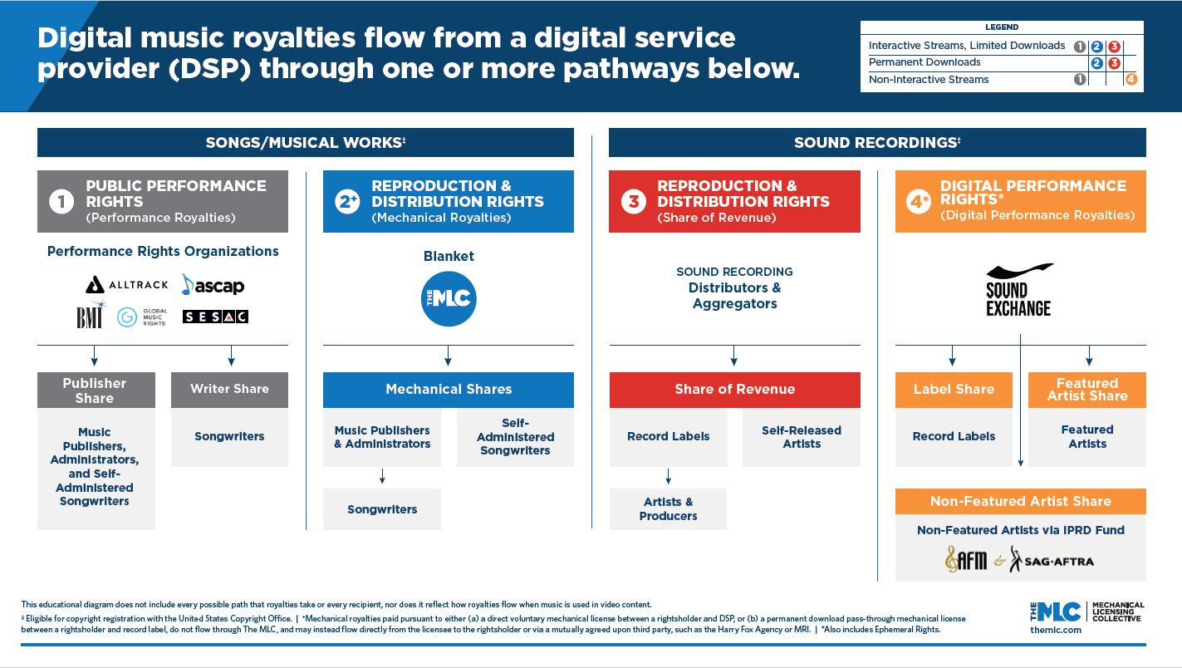
Digital Music Royalties Landscape
Notes:
In order to understand what the MLC does, it can be helpful to see where it fits in the digital music royalties landscape.
This diagram is on the MLC website under the Resources section. It shows the 4 ways that money flows related to audio-only digital uses of music in the U.S. It does not include information about how money flows for video uses or uses outside of the U.S.
The first thing to look at is the Legend at the top right. It lists the different digital uses and then indicates which of the four pathways, each representing a type of royalties, are generated by that use. Note the colors and numbers, 1-4.
For example, for an interactive stream, there are three types of royalties created, involving column 1, 2, and 3. An interactive stream generates a mechanical royalty and a public performance royalty, as well as revenue for the sound recording rightsholders.
The left side of the screen describes royalty pathways related to use of musical works, and the right side royalty pathways related to the use of sound recordings
Pathway #1 is for public performance of musical works, and that is where you find PROs listed (performing rights organizations)
Pathway #2 is for the reproduction and distribution of musical works in recordings (in other words, mechanicals), and that is where you find the MLC
Pathway #3, is for the reproduction and distribution of sound recordings, and that is where you find record distributors and aggregators and record labels listed
Pathway #4, is for the digital public performance of sound recordings, and this is where you find SoundExchange listed.
A key take away from this slide is that The MLC is not replacing the parties in the other royalty pathways. It is an addition to the landscape, not replacing other organizations.
In the #2 mechanicals pathway, what is displayed is the blanket license path. There also exists a voluntary license path – copyright owners and administrators can still enter into direct voluntary licenses with DSPs and they can decide between them who will administer the license, and may use third party administrators like HFA and Music Reports to assist. Downloads can flow through The MLC, or continue to be handled as pass-through licenses where the record company secures the license and passes it through to the DSP.
Please consider spending more time on this image on The MLC’s website if you want to understand this in more detail.

Slide 15
What The MLC Does and Does Not Do
The MLC . . .
The MLC does NOT . . .
Administers a new BLANKET COMPULSORY MECHANICAL LICENSE available to eligible DSPs operating in the United States
Receives and MATCHES sound recording usage data from DSPs with The MLC’s musical works ownership data
Collects and DISTRIBUTES U.S. DIGITAL MECHANICAL ROYALTIES to musical works rightsholders
Established and maintains a PUBLIC DATABASE of musical works ownership information
Replace PROs in administering performance rights for musical works or collect PERFORMANCE ROYALTIES
Replace SoundExchange in administering digital performance rights for sound recordings or collect DIGITAL PERFORMANCE ROYALTIES
Administer mechanical rights or collect mechanical royalties for PHYSICAL PRODUCTS
Administer any licenses or collect any royalties related to the use of musical works in AUDIOVISUAL (VIDEO) PRODUCTS or LYRICS
Administer licenses or collect royalties for the use of musical works OUTSIDE THE U.S.
Notes:
Another way of understanding the scope is to review what The MLC does and does not do. We often discuss this so that rightsholders understand there are other sources of revenue they may be entitled to, and they need to solve for how they will collect that revenue
[Read the slide text]

Slide 16



Who Needs to Connect to Collect?
Connect to Collect™
means
Become a Member
Who should
Connect to Collect ™?
The party who administers the publishing
for the song
in the United States
No separate writer share and publisher share
Not like how it works at a PRO
Notes:
Who need to Connect to Collect with The MLC?
That is The MLC’s catch phrase that means become a Member
The answer to that is the party who administers the publishing for the song in the United States
There are no separate writer shares and publisher shares with The MLC or when you are talking about mechanical royalties
It does not work the same way as it does for a performing rights organization that has a separate writer share and publisher share

Slide 17
Who is Administering the Publishing?
U.S. based (song-level analysis)
Publishing Activity
Creative Publishing Activities: Cultivate the songwriter’s creativity (writing camps, co-writes) Pitch/license songs to music supervisors and recording artists
Administrative Publishing Activities: Register songs with PRO Register songs with The MLC Track and collect royalties Register songs with the U.S. Copyright Office
Self-Administered Songwriter
Songwriter
Songwriter
Administered Songwriter
Songwriter
Publishing Administrator
Published Songwriter
Publisher
Publisher
Need to Connect to Collect™
Notes:
How do we know who is administering the publishing?
First it can be helpful to understand that publishing activities generally fall into two categories
The first are creative publishing activities. These involve:
Cultivating the songwriter’s creativity (writing camps, co-writes
And pitching and licensing songs to music supervisors and recording artists
The second are administrative publishing activities
Registering songs with PRO
Registering songs with The MLC
Tracking and collecting royalties
Registering songs with the U.S. Copyright Office
So imagine a scenario where we are talking about a songwriter, publisher, or publishing administrator based in the U.S.
This is a song level analysis – we have to analyze this for each song and ask the question, who is administering the publishing for the song?
If we have a self-administered songwriter, they are handling all of the creative activities on their own, and all of the publishing activities on their own. This is what it means to be self-administered or self-published. They are administering the publishing for the song.
If we have songwriter who is handling the creative activities on their own, but has done a deal with or signed up with a publishing administrator, then the publishing administrator is administering the publishing for the song.
If we have a songwriter who has a publisher handling the creative activities and the administrative activities, then the publisher is administering the publishing for the song.
For each of these scenarios, for a given song, it is the parties circled in yellow who are administering the publishing for the song, and need to become a Member of The MLC.

Slide 18
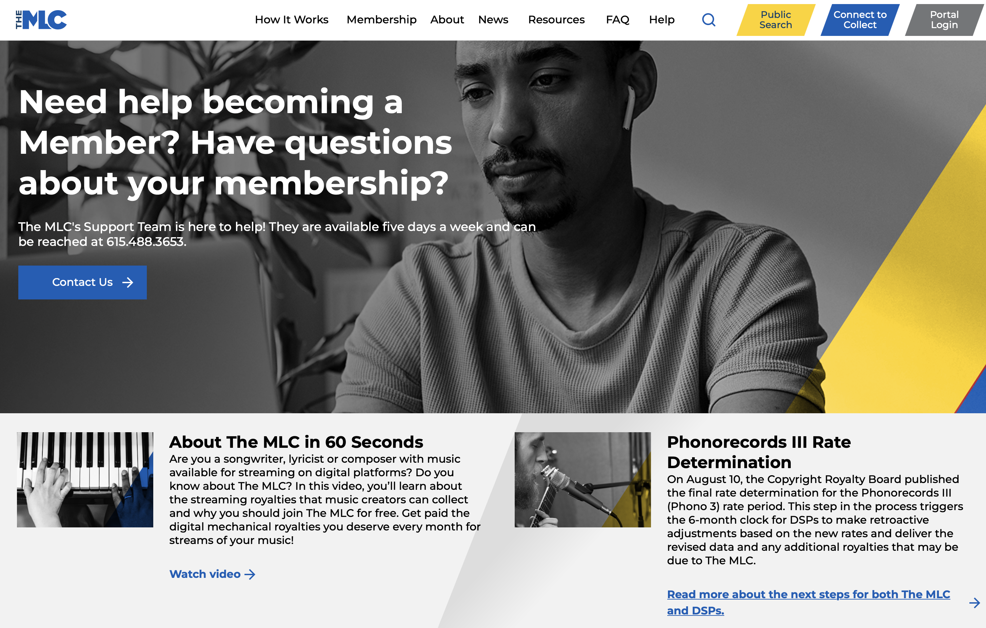


How Do You Become a Member of The MLC?
To become a Member, visit www.themlc.com and click the blue “Connect to Collect” button
DSPs pay 100% of The MLC’s operating costs.
The MLC distributes 100% of the royalties it collects to Members
without deducting any administration fees
Membership is
FREE
Notes:
It is very easy to become a member. There is a Connect to Collect button at the top right on our website where the process is kicked off.
Membership is free, and in fact The MLC does not take an administrative fee out of the royalties we collect to pay for our operating expenses. The copyright law requires the digital music services to pay for the cost of operating the MLC.
That means that the MLC can distribute 100% of the royalties it receives to its Members.

Slide 19





What happens next?
Play Your Part™
Banking Details
Register your Claims in Works
Match to
Recordings
Get Paid
Royalties
Set up your banking details so we can pay you
Use our tools to claim your share of works in our database or add new works to our database
Use our tool to match your works to related sound recordings
Receive and review your royalty statements and related payments
Notes:
After becoming a Member of The MLC, there are several other important steps for Members to complete
Play Your Part is our catch phrase for this activity.
Members need to set up their banking details so that we can pay them electronically
Members need to register their claims to the musical works they administer. There are a variety of tools we have available to help with this.
Members also have the opportunity to search sound recording usage data reported to The MLC by the digital services to recommend matches of the sound recordings to their works.
Members are encouraged to review their royalty statements and related payments to make sure nothing is missing

Slide 20
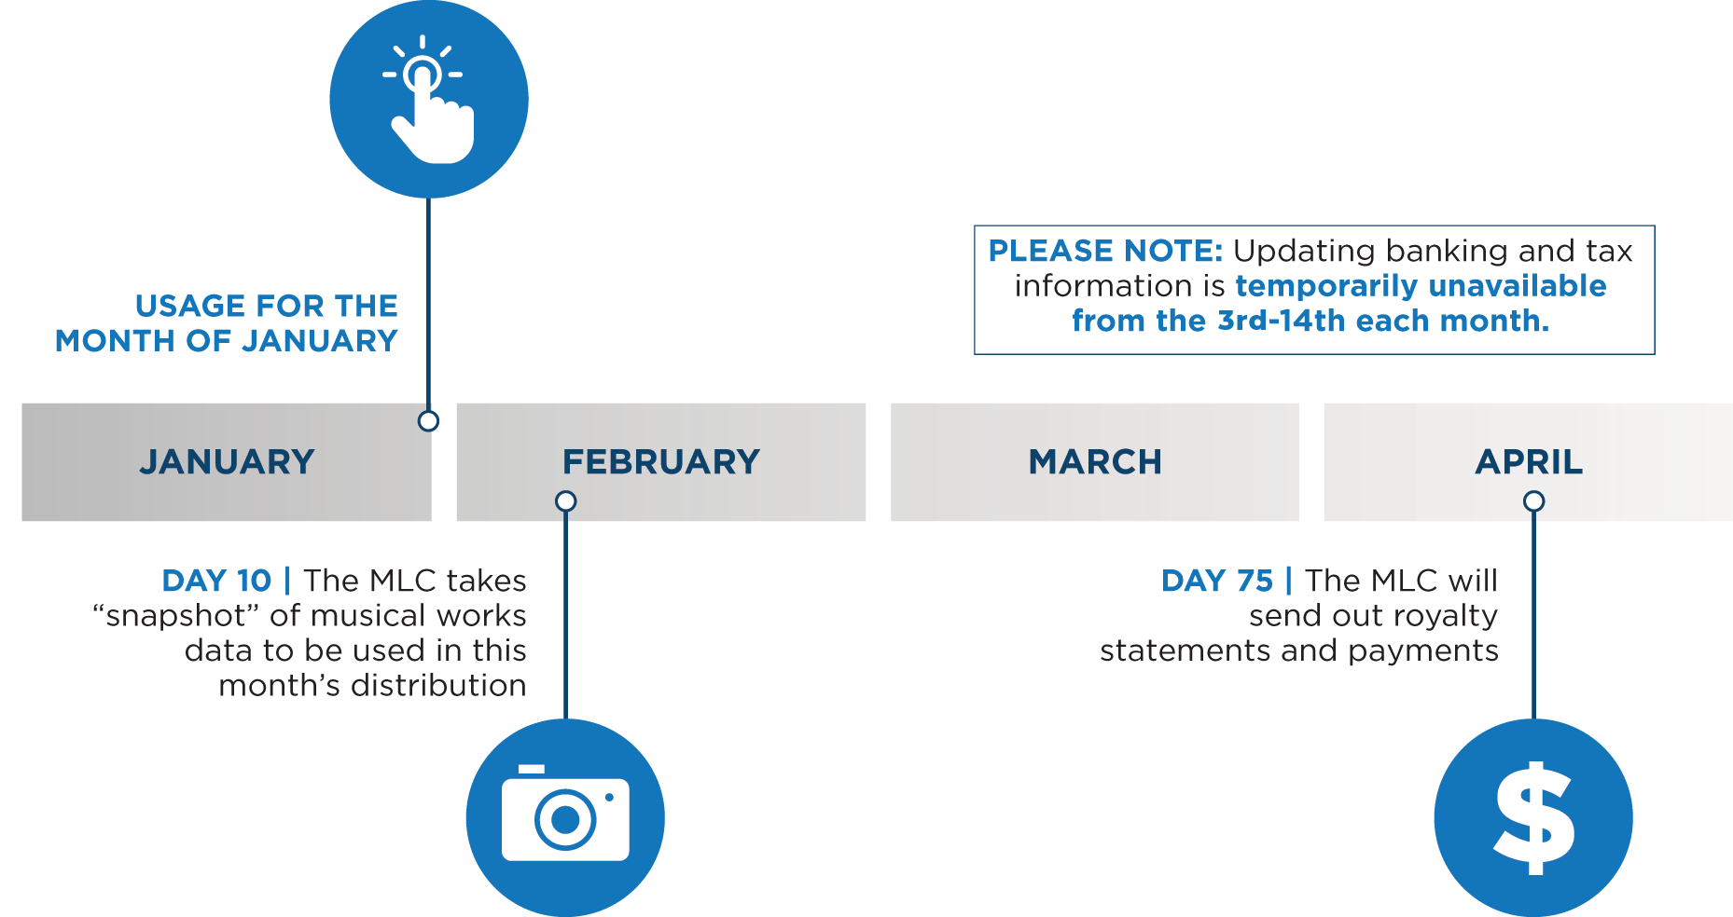
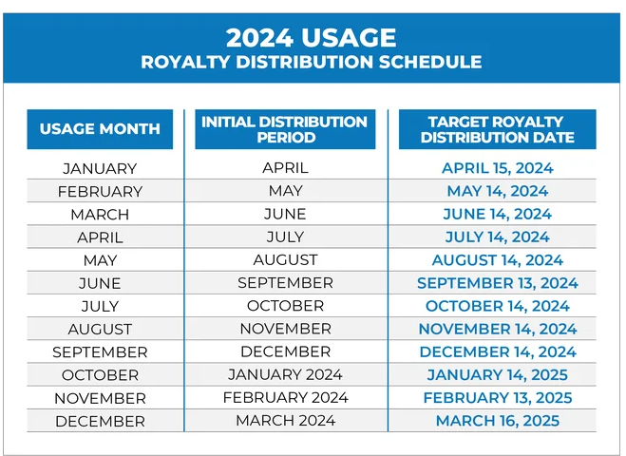
Royalty Distribution Timeline
Distribution Payout To Date
$2B+
*As of April 2024 Distribution
Timing & Cadence of Royalty Payments
Monthly
75 days after the end of the month
when the activity took place
Notes:
Members get paid royalties on a monthly basis, 75 days after the end of the month the usage activity took place.
For example, a stream that takes place in January would be paid on the royalty statement issued in mid-April.
In order for the use of a musical work to be paid on this timeline, the musical work information has to be set up by the 10th day of the month following the activity.
If that date is missed, once the work is set up, the prior period royalties will be included in the next 75-day royalty statement process.
Eventually but not sooner than three years or so from when the activity took place, royalties which have remained unclaimed will be put into a pool of royalties that will be distributed to Members on a pro-rated basis. More information on how that process will work will be published by The MLC as we get closer to that distribution.

Slide 21




Statutory Royalty Rates
Pre-Phono I or “Pre Phono 1” | Phono I or “Phono 1” | Phono II or “Phono 2” | Phono III or “Phono 3” | Phono IV or “Phono 4”
2007 | 2008-2012 | 2013-2017 | 2018-2022 | 2023-2027
Fixed amount per sale
Variable amount per stream which varies by the service offering by a DSP each month
37
CFR
Part 385
Permanent Downloads
Ringtones
Physical Products
Interactive Streams
Limited Downloads
= $X
= ((Greater of A or B) – (C))
D
Notes:
The royalty rates used by The MLC are called Statutory Royalty Rates and are set by the Copyright Royalty Board.
The rates are found in the Code of Federal Regulations (CFR) at 37 CFR Part 385
The rates are set for a 5-year period, and each rate period is given a short name to make it easy to refer to. The Phono IV period applies to 2023-2027.
The rates are calculated differently for permanent downloads, ringtones, and interactive streams and limited downloads.
The MLC has published an explanation of the digital rates, along with a helpful video, on its website.

Slide 22

Blanket v. Historical Unmatched Royalties
JAN
1
2021
Historical Unmatched Royalties
(HU)
Blanket compulsory mechanical license for digital uses went into effect
Blanket Royalties
(B)
Prior To January 2021
January 2021 and forward
DSPs operated under work-by-work licenses
DSPs began operating under the blanket license
The MLC began collecting royalties due under the blanket license from DSPs
Royalty Distributions
Historical Unmatched royalties were transferred from the DSPs to The MLC in 2021
The MLC began to pay out HU royalties in June 2022
Has continued ever since
Royalty Distributions
The MLC began to pay out Blanket royalties in April 2021
Distribution occurs on a monthly basis, 75 days after each usage period
More information about Historical Unmatched Royalties is available on the website www.themlc.com
under How It Works, then Historical Unmatched Royalties
Notes:
On January 1, 2021, the new blanket compulsory mechanical license for digital uses went into effect. That date has created a sort of dividing line in terms of royalties.
Streaming services have been operating since the mid-2000’s and as I mentioned before, some rightsholders have never received their mechanical royalties for uses of their music on interactive streaming services, under the work-by-work license model.
The MMA gave digital services a legal safe harbor protecting them from being sued for unpaid mechanical royalties so long as they transferred the unpaid royalties they were holding as of December 31, 2020 and the related data, to The MLC.
The services transferred almost $400 million dollars of what is called Historical Unmatched royalties.
Since then, The MLC has been cleaning up the data, loading, matching, and paying out much of this money. Payouts started in the summer of 2022 and continue every month.
On royalty statements, royalties are labeled as either Historical Unmatched or Blanket Royalties and include the month the activity took place.
There is an entire page on The MLC’s website dedicated to explaining this topic.

Slide 23

Key MLC Stats
As of May 2024
Distributed $2+ billion in blanket royalties
All Royalty Distributions have been On-Time or Early
Currently matching 90.3%+ of total royalties processed
Enrolled nearly 40,000 Members
Grown Public Database to ~37 million works
Continued to make SERVICE a priority
Notes:
[read the slide]

Slide 24









For more information, please visit: www.TheMLC.com
www.TheMLC.com
Facebook | @MLC.US
The Mechanical Licensing Collective
Twitter and Instagram | @MLC_US
@MLC_US
@MLC_US
@MLC.US
The MLC
LinkedIn | The Mechanical Licensing Collective
Notes:
For more information about The MLC, visit the website at www.themlc.com.
And keep in touch with them to learn about upcoming webinars and events by following them on social media.

